Slide 1
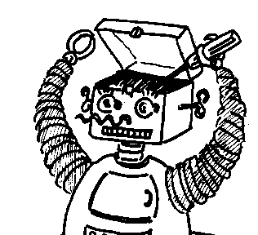
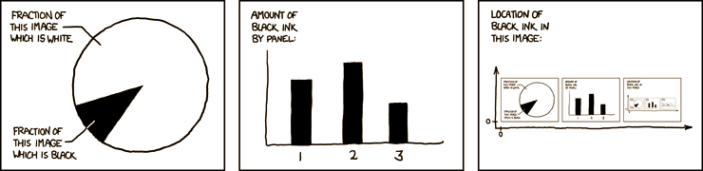

Maryland Metacognition Seminar
http://xkcd.com/
Toward Robot Consciousness Antonio Chella
University of Palermo, Department of Computer Engineering
23 August 2012, 12:00 PM
A. V. Williams Bldg., Rm. 3258, College Park
Abstract:
Machine consciousness is a seminal field placed at the crossing between technical disciplines (AI, robotics, computer science and engineering), theoretical disciplines (philosophy of mind, linguistic, logic), and empirical disciplines (psychology and neuroscience). On the one hand there is the hope that facing the problem of consciousness would be a decisive move to design better AI systems, on the other hand the implementations of AI systems could be helpful for understanding consciousness. The first part of the talk will present the current state of research in machine consciousness, while the second part will introduce Cicerobot and Robobico, two related projects.

